Slide 1
Science for Life Laboratory
Eva Molin
Acting Site manager

Slide 2
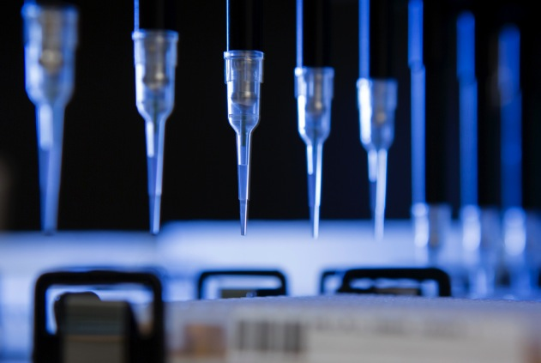
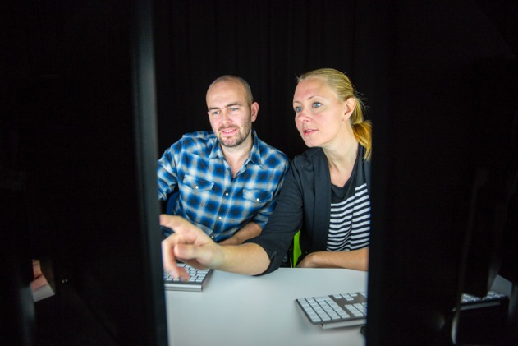

4 host universities
Established in 2010
National resource since 2013
More than 1000 researchers

Slide 3
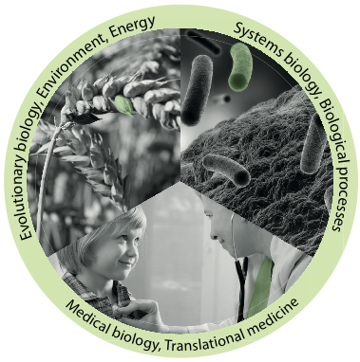
Vision
To be an internationally leading center that develops, uses and provides access to advanced technologies for molecular biosciences with focus on health and environment

Slide 4
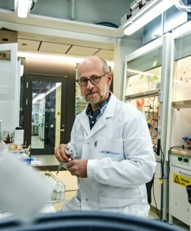
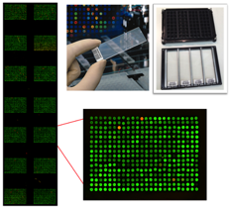
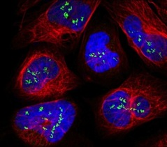
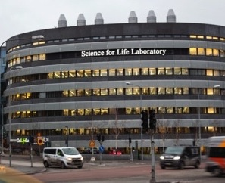
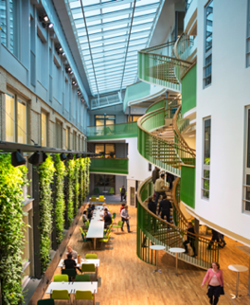
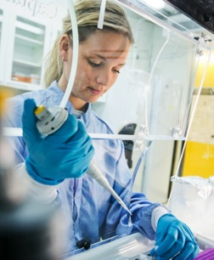
Mission
Technology platforms for national use
Service to research community
Technology development
Education
Strong research community
Strong interdisciplinary community
SciLifeLab Fellows Program
National projects
Society impact
Health care outcome
Environment
Tech transfer, spin-offs, industry collaborations

Slide 5

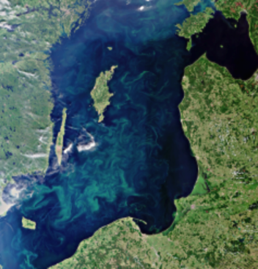
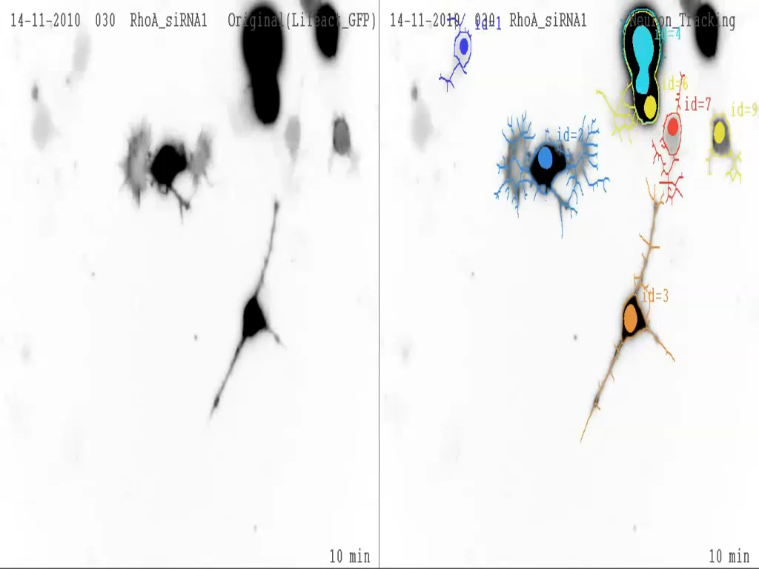
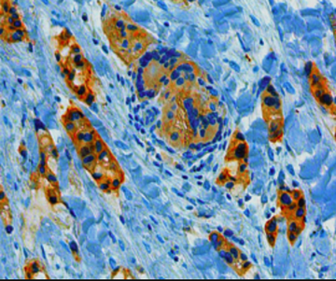
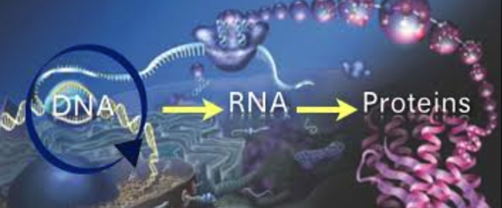
The range of life sciences studied
Ecosystems
Communities
Populations
Organisms
Organs
Tissues
Cells
Organelles
Molecules

Slide 6
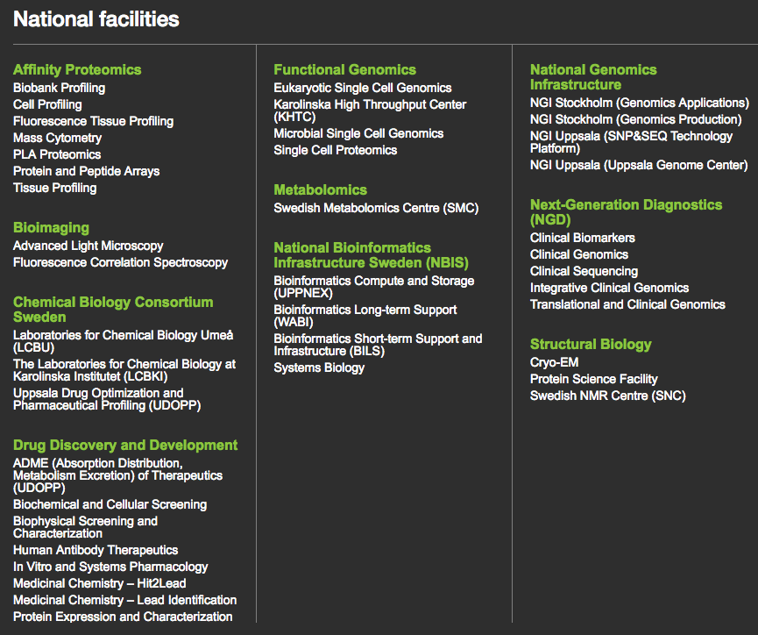
Platforms and facilities

Slide 7
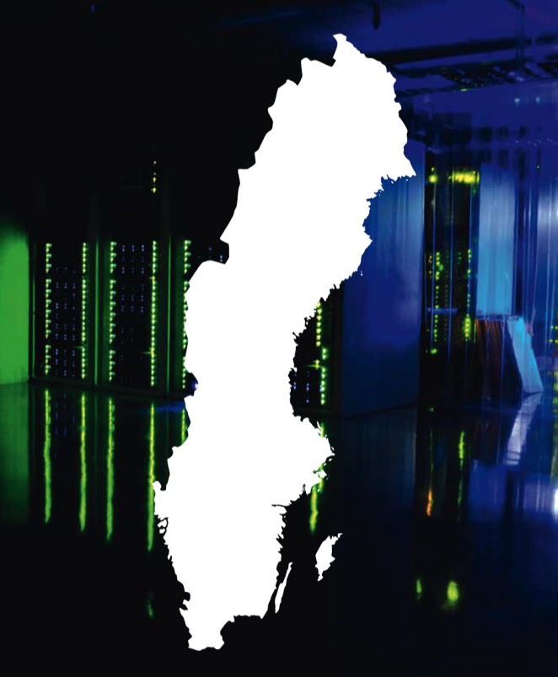
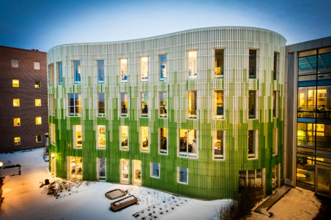
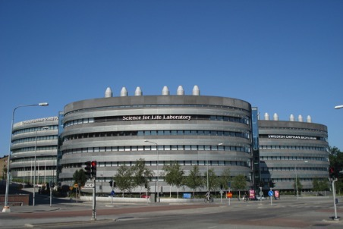
Nodes and sites
Uppsala node
Umeå
Stockholm node (Solna)
Linköping
Göteborg
Lund
Notes:
SciLifeLab comprises technologies and competence at several Swedish Universities outside Stockholm and Uppsala:
Linköping University
Gothenburg University and Chalmers
Lund University
Umeå University
Swedish University of Agricultural Sciences Umeå

Slide 8
Platforms and facilities

Slide 9

www.nbis.se

Slide 10
Why bioinformatics infrastructure?
A continuous technical scale‐up will provide an unprecedented amount of heterogeneous omics data
- Support, Tools, Training
System‐level analyses in biomedical research will transform life science
- Strategic positioning in systems biology
Large‐scale omics is will make a major leap into translational research and diagnostics
- Method adaptation and expert advice
Notes:
remarkable

Slide 11
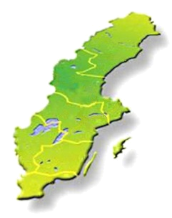
User access to NBIS
Study design consultation (free)
Short & medium-term support
8 hours for free, then 800 SEK/hour
http://www.nbis.se/support/supportform/index.php
Apply anytime
Long-term support (500h; free: scientific evaluation) http://www.scilifelab.se/facilities/wabi/
Next deadline: October 2016
Compute and storage (free; majority of hardware and system administration belongs to SNIC)
Apply: https://supr.snic.se
Read more: http://www.uppmax.uu.se/

Slide 12
Bioinformatics Drop-In
Are you planning a project and need someone to discuss the bioinformatics analysis with?
Do you need bioinformatics support, but do not know who to turn to?
Are you stuck in your own bioinformatics project and need help?
Meet the NBIS staff at bioinformatics drop-in
Similar activities in the other NBIS nodes/cities
Uppsala
When: Weekly on Thursdays
at 10-11 am
Where: SciLifeLab, level 3
Stockholm
When: Weekly on Tuesdays
at 10.30-11.30 am
Where: SciLifeLab, gamma, level 6

Slide 13
Upcoming courses
Date | Course
November 14-16 | De novo Genome Assembly
November 22-23 | Metagenomics
Nov 28-Dec 2 | Introduction to Bioinformatics using NGS data
Nov 28-Dec 2 | R Programming Foundations for Life Scientists
Application Nov/Dec | The Swedish Bioinformatics Advisory Program

Slide 14
Upcoming courses
Date | Course
November 14-16 | De novo Genome Assembly
November 22-23 | Metagenomics
Nov 28-Dec 2 | Introduction to Bioinformatics using NGS data
Nov 28-Dec 2 | R Programming Foundations for Life Scientists
Application Nov/Dec | The Swedish Bioinformatics Advisory Program

Slide 15
The Swedish Bioinformatics Advisory Program
A new teaching model, where PhD students get a senior bioinformatician as a personal advisor during 2 years of their PhD.
Monthly project meetings + two grand meetings per year to aid networking and knowledge transfer.
First call late 2014:
>50 applicants for 15 places
www.scilifelab.se/education/mentorship/the-swedish-bioinformatics-advisory-program/
Next call Nov-December 2016

Slide 16
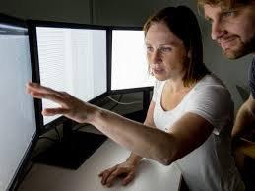
Why this program
Overall aim: Great research in Sweden!
How? Strategic investment in PhD education Complementing PhD supervisors with technical expertise
Catalyze transition to large-scale data analyses
The PhD student is responsible to prepare and drive the meetings!

Slide 17


Science & SciLifeLab Prize
A grand prize winner receives a prize of US $30,000; and each of the three category winners will receive US $10,000
The grand prize winning essay will be published in Science and essays from the three category winners will be published online
“to incent our best and brightest to continue in their chosen fields of research”
Notes:
Cell and Molecular Biology
Ecology and Environment
Genomics and Proteomics
Translational Medicine

Slide 18
www.scilifelab.se

